Slide 1

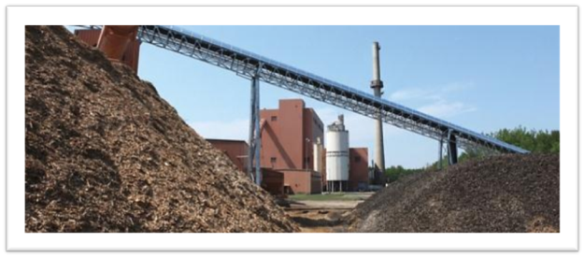
Generating Electricity from Sustainably
Harvested Biomass Material
NYS Science Teachers and Master Teachers
February 28, 2015

Slide 2
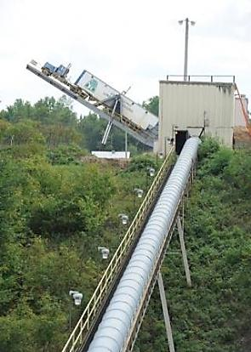
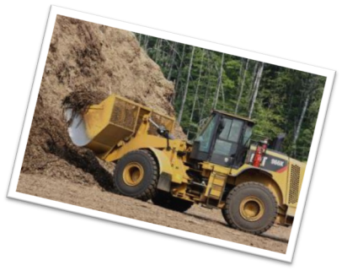
About Biomass-Derived Energy
Generating sustainable electricity from responsibly harvested green forest residue and other wood waste
Notes:
At our facilities, we use sustainably harvest forest residue to generate electricity. I’ll explain what I mean by “forest residue”: When trees are harvested, the entire tree is not shipped to a sawmill or paper mill. Some parts of the tree, including branches and tops, are not suitable for the making of products and some of this material is left to provide important habitat and nutrients critical for reforestation. However, that residue is a valuable resource that -- using state-of-the-art technology -- can be converted to fuel to produce energy.
In biomass power plants, forest residues or other residue fuels are converted into steam that runs a turbine to make electricity or heat that is then provided to industries and homes. Highly advanced combustion engineering and process controls minimize emissions from biomass fuel sources when compared with fossil fuels such as coal, natural gas and oil.

Slide 3
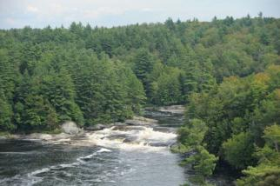

Benefits of Biomass-Derived Energy
$1 billion to nation’s economy
15,000+ jobs in our sector alone
Supports rural economies
Enhances forest health
Reduces our dependence on fossil
and foreign fuels
Reduces greenhouse gases
Enough power for 1 million homes
Potential for growth
Notes:
Biomass power producers use sustainably-sourced organic low-value waste materials such as residues and byproducts left over from forest harvests, farming, and the collection of urban wood to create electricity for sale to the grid (and heat).
Biopower facilities are located in more than 20 states.
Every 1 MW of biopower supports about 5 jobs: 1 at facility (direct) and the rest in the community.
The biomass sector creates more long-term jobs per unit of energy than any other renewable energy alternative.
Biopower creates and supports rural jobs and also enhances forest health by supporting sustainable forestry activities. As you know, a sustainably managed forest is healthier than an unmanaged forest.
These numbers reflect the current impact of the biomass industry. There is significant potential for biomass energy anywhere with a thriving forestry industry, especially the Southeast. In addition, in some cases, agricultural waste like oat or rice hulls can make for a reliable feedstock.

Slide 4
Energy Mix in the U.S.
1%
19%
30%
U.S. Energy Information Administration, 2012
Notes:
As this chart shows, about 12% of our energy in the U.S. comes from renewables. New York’s North Country is a national leader in renewable energy, alone providing 30% of the State’s grid-tied renewable electricity. More than 94% of the Region’s electricity is generated from hydro, wind and biomass.

Slide 5
Biomass as Percentage of Total Renewables
1%
3%
12%
56%
28%
U.S. Energy Information Administration, 2012
Notes:
Biopower is a significant part of the renewable power mix.

Slide 6

Biomass Power in the U.S.
Notes:
This map, developed by the Biomass Power Association shows the locations of biomass-to-electricity facilities. The states with these facilities are colored in green. It is difficult to see the dots, but each facility is represented on the map. The facility is particularly robust on each coast and in the state of Minnesota.

Slide 7
Fast Facts – ReEnergy Holdings
Headquartered in Latham, NY
Established 2008
More than 300 employees; 6 states
Notes:
The company I work for, ReEnergy Holdings, has become a major player in the biopower sector. ReEnergy is a portfolio company of Riverstone Holdings LLC, owns and operates facilities that use forest-derived woody biomass and other wood waste residues to produce homegrown, renewable energy. It also owns facilities that recycle construction and demolition debris. ReEnergy was formed in 2008 by affiliates of Riverstone Holdings LLC and a senior management/co-investor team comprised of experienced industry professionals. ReEnergy operates in six states, employs approximately 315 people, and owns and/or operates nine energy production facilities with the combined capacity to generate 325 megawatts of renewable energy

Slide 8
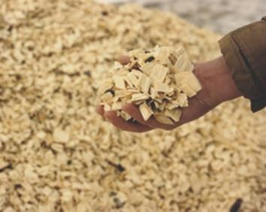
Fast Facts – ReEnergy Holdings
325 MWs of renewable
energy generation (NY, ME, CT, NC)
700,000 tons per year of
C&D/wood recovery processing
capacity (NH, MA, ME)
Notes:
Our nine energy facilities are in four states: New York; Maine; Connecticut and North Carolina
Our resource recovery facilities are located in the metro Boston area

Slide 9
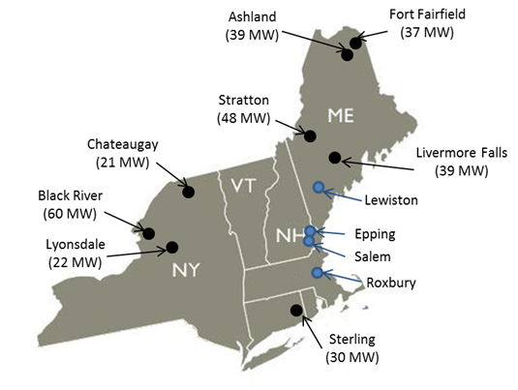
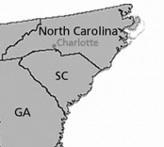
ReEnergy Holdings Portfolio
Coastal Carolina Clean Power
(30 MW)
Notes:
This map shows the ReEnergy portfolio. Our business at this time is focused in the eastern part of the U.S., and includes a facility in North Carolina that we operate and manage.

Slide 10
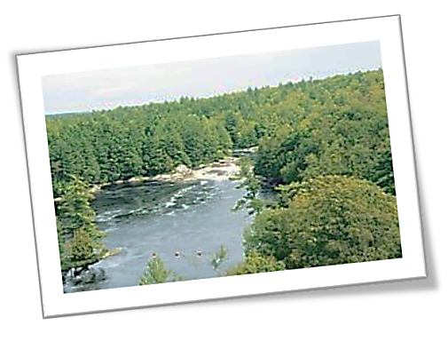
Benefits of Biomass-Derived Energy in NYS
Abundance of forestland in NYS
Overabundance of low-quality and unhealthy trees
More than a million acres of idle farmland
Notes:
New York State has abundant forestland and farmland: More than 40% of NYS is forestland, an increase of >400% from 100 years ago

Slide 11
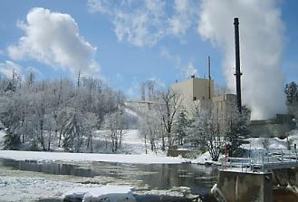
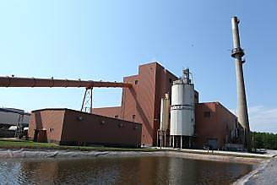
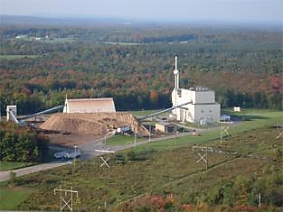
ReEnergy Facilities in New York State
ReEnergy Black River: 60 MW; power to Fort Drum and excess to the grid. Enough power for 55,000 homes
ReEnergy Lyonsdale: 22 MW; steam to Burrows Paper and power to 21,000 homes
ReEnergy Chateaugay: 21 MW: When operating, enough power for 20,000 homes
Notes:
Our energy facilities in New York are all in the North Country, which allows us to utilize the rich natural resources of this region. We’ll be talking in great detail about Black River. Our Lyonsdale facility, in Lewis County employs 22, and supports another 100+ jobs indirectly through $6.6 million in fuel purchases. Our Chateaugay facility in Franklin County is idled at this time due to energy market conditions and the value of its contract for renewable energy credits, but we are investigating options to restart that facility.

Slide 12
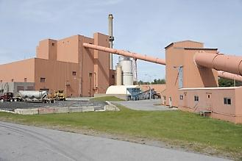
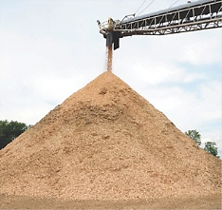
ReEnergy Black River Fast Facts
Inside the fence at Fort Drum
Retrofitted coal-burning facility
Purchased by ReEnergy in December 2011
Awarded 10-year contract with NYSERDA for sale of renewable energy attributes
Awarded 20-year contract to supply all of Fort Drum’s power needs; largest renewable energy contract in history of U.S. Army.
Notes:
Highlights about Black River:
The coal-fired circulating fluidized bed facility was originally built in 1987. It was designed to provide district heating to buildings on the Fort Drum Army installation and electrical power for sale on the regional grid. Soon after initial construction, the power plant stopped selling thermal energy to Fort Drum and became a merchant electrical generation station.
The plant was designed to burn coal, pet coke, and a limited amount of tire-derived fuel. It was idled in 2010 by the prior owner for financial reasons.
ReEnergy acquired the 60-MW facility in December of 2011. It is located inside the fence at Fort Drum, a U.S. Army installation located just outside of Watertown, NY.
When we acquired it, it was an idled coal-burning facility, but we had done a great deal of analysis to determine that it was feasible to convert it to use biomass as its primary fuel. The project was competitively selected by the New York State Energy Research and Development Authority (NYSERDA) to sell renewable energy credits (RECs) to NYSERDA for 10 years under New York’s Renewable Portfolio Standard. The Renewable Portfolio Standard, administered by NYSERDA, is a program that is tasked with obtaining 30 percent of New York’s electricity from renewable sources by 2015.
Our business thesis was to convert to biomass and sell a portion of the power to Fort Drum and sell RECs to New York State while sourcing sustainably harvested biomass and other available fuel sources from the local region.

Slide 13







Partners and Alliances
Notes:
We have developed strong relationships in New York State, and the North Country region is strongly in support of harnessing the region’s natural resources to create homegrown renewable energy.
One of the top priorities of the North Country Regional Economic Development Council is to “create the greenest and most self-reliant energy economy in the state.” The North Country is already a national leader in renewable energy, alone providing 30% of the State’s grid-tied renewable electricity. More than 94% of the North Country region’s electricity is generated from hydro, wind and biomass. The Council also points to strong opportunities in the biomass sector, saying that the region’s biomass resources are “unparalleled” in New York State.

Slide 14

Economic Benefits of Biomass Power
A form of renewable energy with significant ongoing economic impact:
1 MW = 5 jobs
Notes:
The facility’s annual operating exceeds $20 million, but more than half of that budget – about $11 million – will be spent on fuel purchases from local loggers. ReEnergy’s policy is to locate its facilities in regions capable of supplying raw materials while simultaneously ensuring the long-term sustainability of the forests where those facilities are located.
Here you see some images of some of our suppliers.

Slide 15
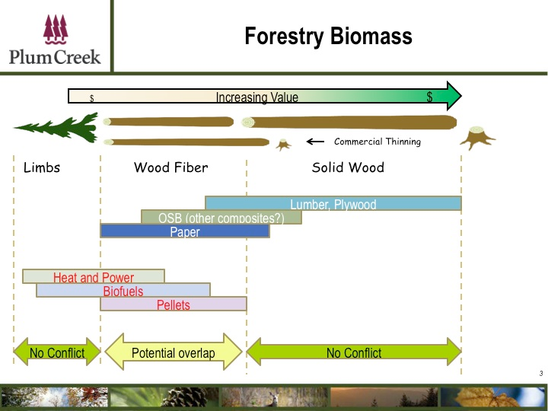
A Market for Low-Value Forest Material
Notes:
Biomass is an attractive alternative to fossil fuels because it is a renewable resource. Northern NY is rich with forests, and this project provides a homegrown energy solution to the region. The use of biomass allows the region to better control its economic and energy destiny and reduces our dependence on foreign fossil fuels. We buy wood residue that is harvested in accordance with best management practices that promote resource sustainability. Generally, we make use of the residue that loggers sometimes leave behind – the branches and tops of trees that are not shipped to mills for other uses. This chart shows the various parts of a tree, from low-value to high-value. Loggers send us the low-value material for use in energy production. They typically do not send us higher-value material, since they would get more revenue by selling that material to mills making paper or lumber.

Slide 16
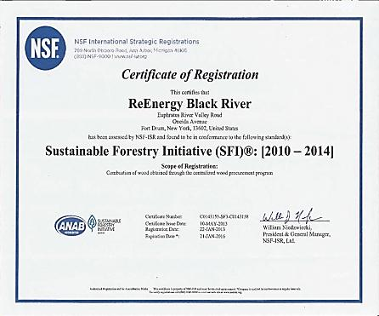
SFI Certification
First company solely devoted to electricity production to be certified by SFI
Commitment to use best management practices and protect forest health
Notes:
This SFI certification verifies that ReEnergy’s biomass procurement program promotes land stewardship and responsible forestry practices. ReEnergy is the first company solely devoted to electricity production to be certified to the SFI Standard.
ReEnergy earned the certification by meeting the fiber sourcing requirements of the SFI Standard. This includes an auditable procurement process to promote responsible forestry requiring that producers, among other things, support logger and forester training and encourage suppliers in North America to reforest harvested sites, protect threatened and endangered species, and strengthen best management practices to protect water quality.
SFI, Inc. is an independent, 501(c)3 nonprofit organization responsible for maintaining, overseeing and improving a sustainable forestry certification program that is internationally recognized and is the largest single forest standard in the world. The SFI Standard is based on principles and measures that promote sustainable forest management and consider all forest values.
To achieve the SFI Standard Principles, Objectives, Performance Measures and Indicators, ReEnergy developed and adopted programs to guide its wood fuel procurement activities. ReEnergy is committed to annually review the effectiveness of its SFI Policy, procedures, and systems and to continually improve its sustainable forestry program. An important element to implement the SFI Standard is an annual management review process to foster perpetual improvement and independent third-party audits to certify conformance.

Slide 17

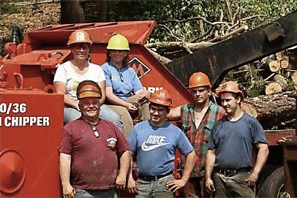
Equipment Leasing Program
ReEnergy launched a program allowing loggers to gain access to state-of-the-art equipment and secure long-term agreements to provide fuel to ReEnergy
Notes:
I would like to make note here of our innovative “chipper program.” ReEnergy has acquired and leased state-of-the-art wood chippers to 15 of its fuel suppliers in New York State, allowing loggers to secure long-term agreements to provide fuel to ReEnergy biomass-to-energy facilities while also buying state-of-the-art wood chippers under ReEnergy’s lease-to-own program. Under the terms of these contracts, the loggers will make long-term commitments to sell their biomass fuel to ReEnergy and they will pay for the chippers over time, with the equipment purchase payments deducted by ReEnergy from the payments to the suppliers for the biomass fuel. Ownership of the chipper will transfer from ReEnergy once the supplier has fully paid for the equipment.
About 14 of our suppliers in New York have signed on with this program. We have deployed more than $5 million in capital, and about 75% of our green wood fuel supply at Black River is under contract.

Slide 18
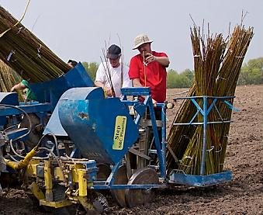
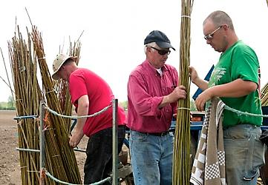

Shrub Willow Used as Fuel
Partnering with SUNY ESF in USDA grant to commercialize shrub willow as fuel
Notes:
Through a program funded by the U.S. Department of Agriculture (USDA) and in collaboration with SUNY College of Environmental Science and Forestry in Syracuse, the ReEnergy Black River facility also will use locally grown shrub willow as a fuel. These photos were taken just two weeks ago at a planting in Cape Vincent by Celtic Energy, which will be one of our suppliers.
The project involves the planting of shrub willow on marginal farmland in Central and Northern New York, and the active counties at this point are Jefferson, Lewis and Oneida counties. ReEnergy will purchase the harvested willow and use the biomass to produce energy at its biomass-to-energy facilities, with the Black River facility accepting approximately 80 percent of the fuel. Over the 11-year life of the project, it is expected that 150,000 green tons of biomass will be produced and used in the ReEnergy facilities. The willow, which can be harvested every three years, will have the potential to continue producing biomass for at least another decade after the program is completed.

Slide 19
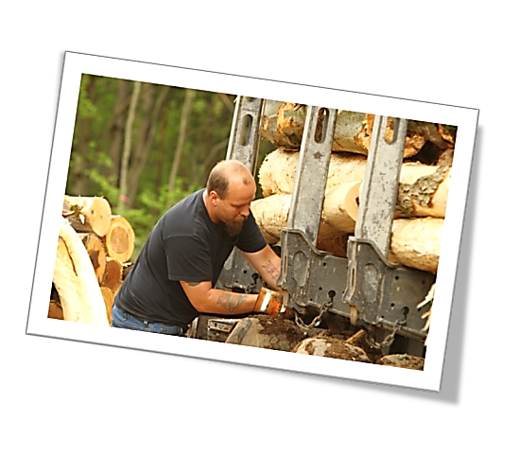
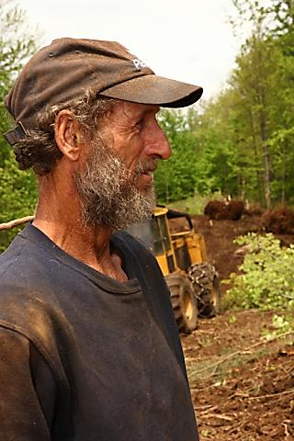

Fuel Supply: North Country
Notes:
Here are some additional photos of some of our suppliers in New York’s North Country.

Slide 20
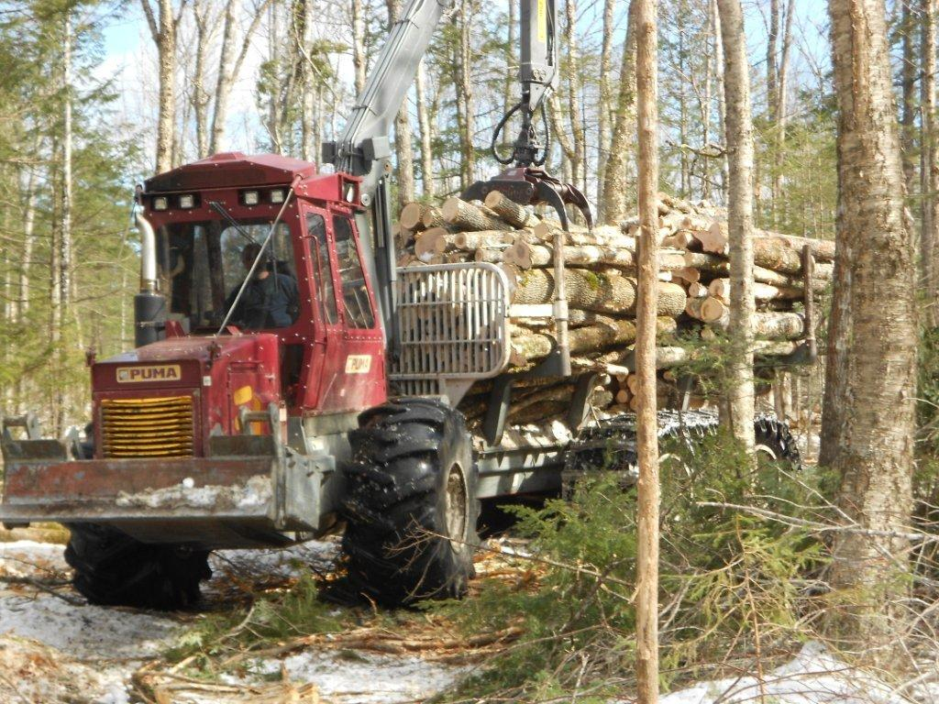
Jobs in the Biomass Sector
ReEnergy provides well-paying jobs at its facilities and supports hundreds of jobs in New York’s forest products industry

Slide 21
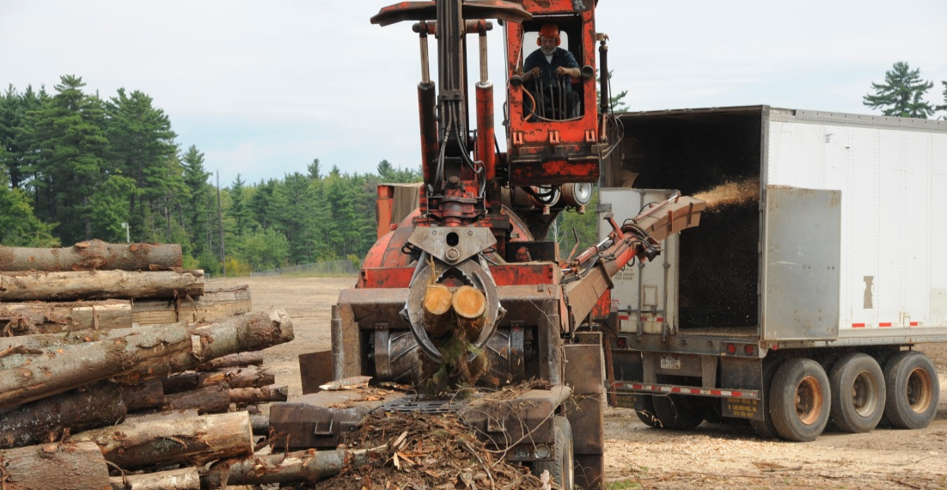
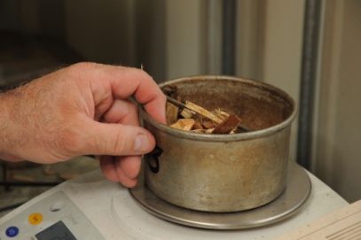
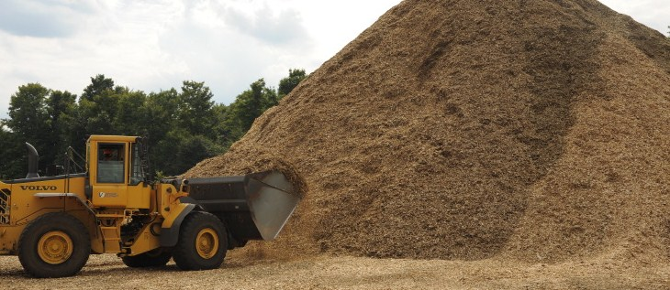
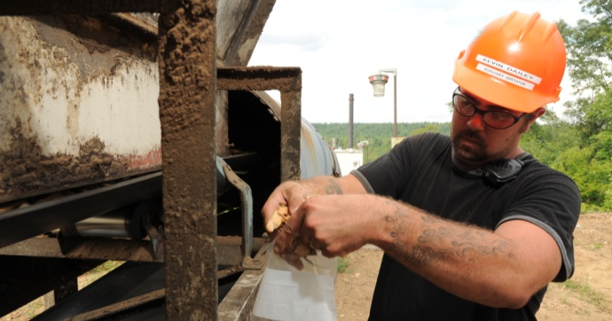
Jobs at ReEnergy
Explore green career opportunities:
Fuel Yard Operator
Wood Fuel Coordinator
Wood Fuel Buyer
Fuel Program Coordinator
Fuel Quality Technician

Slide 22
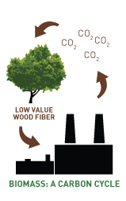
Carbon Benefits of Biomass Energy
Biomass energy plays role in climate change mitigation:
National Climate Assessment Report
EPA Clean Power Plan
Society of American Foresters
EPA analysis of emissions from biogenic sources
Notes:
There is a growing body of scientific findings that concluded that carbon emissions from biomass do not introduce new carbon into the existing natural carbon cycle and play an important role in climate change mitigation. These include:
The White House’s National Climate Assessment in May characterized biomass as “one component of an overall bioenergy strategy to reduce emissions of carbon from fossil fuels, while also improving water quality and maintaining lands for timber production as an alternative to other socioeconomic options.”
In June, the draft Clean Power Plan released by the US Department of Environmental Protection (EPA) recognized that “biomass-derived fuels can play an important role in CO₂ emission reduction strategies.”
In September, the Society of American Foresters (SAF) released a peer-reviewed scientific study entitled “Forest Carbon Accounting Considerations in US Bioenergy Policy,” which was published in the November print issue of the Journal of Forestry. This study confirmed the virtues of biomass, not just as an energy source, but also as an important element for forest health and atmospheric carbon management. The study concluded that energy resources derived from forests have the potential to play an important and ongoing role in mitigating greenhouse gas emissions.
In November, the EPA released its long-awaited analysis of carbon emissions from biogenic sources. The framework declared that biomass is ‘likely to have minimal or no net atmospheric contributions of biogenic CO₂ emissions, or even reduce such impacts, when compared with an alternate fate of disposal’. It was accompanied by a memo to states on counting biomass in Clean Power Plan carbon reduction strategies. EPA has declared that biomass from sustainably managed forest-derived sources, as well as agricultural waste, contribute no net carbon to the atmosphere. This analysis critically underscores the value of biomass as a renewable energy source as states begin to review their compliance obligations to reduce CO₂ under the Clean Power Plan.

Slide 23
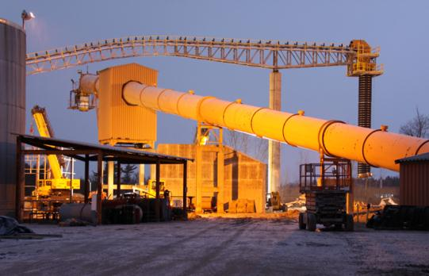
Thank
You

